Slide 1


Your Organization’s Name Here

Slide 2



Slide 3
Today we will…
Understand the impact that a home safety visit campaign can have on our community.
Learn about the FIRE SAFE South Carolina “Core Four” educational messages.
Understand smoke alarm technology.
Understand where to install smoke alarms.
Become familiar with educational materials and the Partner Direct Service Acknowledgement Form that we will use today.
Make a difference that will save lives.

Slide 4

Our Situation
85 Annual Fire Deaths
Top 10 State since 1980s
19,773 Firefighters in 500 Departments 71% Volunteers
5.15 Million Citizens
82% Human Factors
85% Residential
503,000 service calls
6% Fires – 58% Medical
$207 Million in Property Loss
65% of Victims older than age 50
Notes:
Local departments can substitute there own statistics in place of state statistics where applicable.
Notes: 71% of SC firefighters are volunteer

Slide 5

Our Situation
Fires burn differently today than they did a few decades ago.
Notes:
Follow the link on the slide to review the Underwriters Laboratory comparison burn of household furnishings.

Slide 6
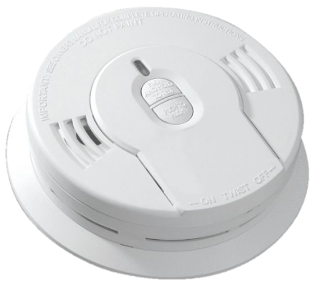
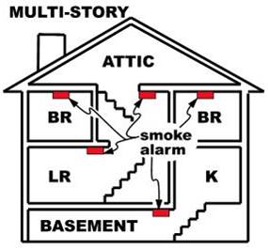
Core Four Safety Messages
Right Alarm – Right Location
The right alarm in the right location may save your life.
Notes:
Say “Today you will learn what kind of alarm goes where. Today you will learn, “Right Alarm-Aright Location”

Slide 7
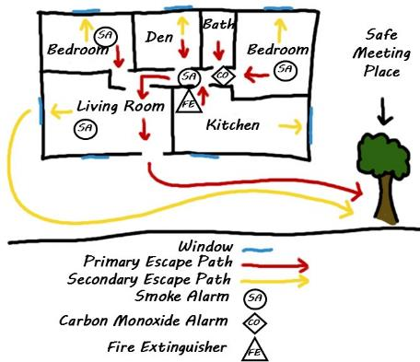
Core Four Safety Messages
Fire Drill Plans and Prep
Practicing a fire drill at home may
save your life.
Sleeping with your doors closed may
save your life.
Properly placed extinguishers may
save your life.
Notes:
Say “Today you will learn how to have a fire escape plan and how to be prepared for a fire in your home.”

Slide 8
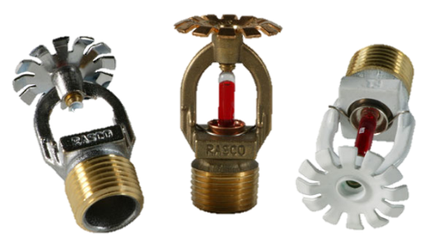
Core Four Safety Messages
Fire Sprinklers Save Lives
Properly installed and maintained fire sprinklers save lives.
Notes:
Say, “Today you will learn some facts about fire sprinklers and understand the benefit that they add to a home.”

Slide 9

Core Four Safety Messages
See a Problem – Take Action
Taking action when you see a problem may save your life.
Notes:
Say, “Today you will learn that taking actions when you see a problem is always the right thing to do.”

Slide 10
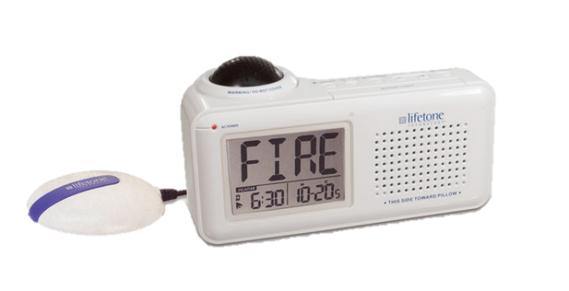

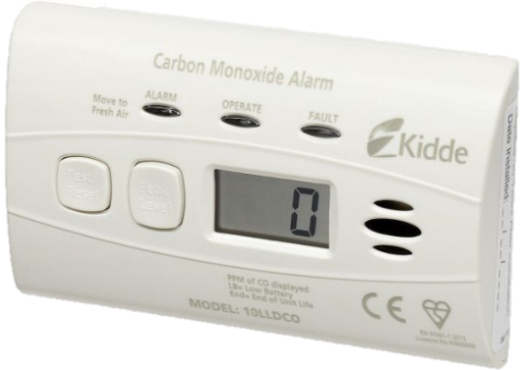
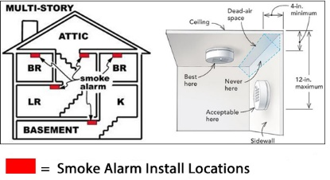
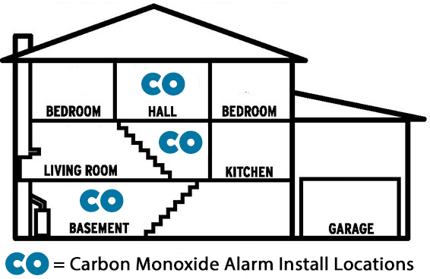
Right Alarm – Right Location

Slide 11
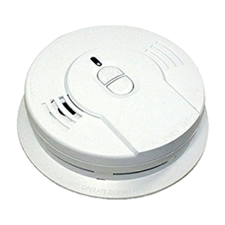
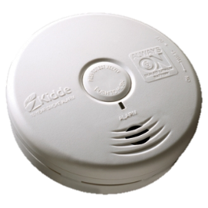
Right Alarm – Right Location
Types of Smoke Alarms
Ionization
Generally more responsive to flaming fires
Photoelectric
Generally more responsive to smoldering fires
Notes:
Ionization smoke alarms are generally more responsive to flaming fires.
How they work: Ionization-type smoke alarms have a small amount of radioactive material between two electrically charged plates, which ionizes the air and causes current to flow between the plates. When smoke enters the chamber, it disrupts the flow of ions, thus reducing the flow of current and activating the alarm.
Photoelectric smoke alarms are generally more responsive to fires that begin with a long period of smoldering (called “smoldering fires”).
How they work: Photoelectric-type alarms aim a light source into a sensing chamber at an angle away from the sensor. Smoke enters the chamber, reflecting light onto the light sensor; triggering the alarm

Slide 12
Right Alarm – Right Location
Smoke Alarm Installation Guidelines
Install smoke alarms inside each bedroom, outside each sleeping area, and on every level of the home, including basements (on the ceiling at bottom of stairs).
On levels without bedrooms, install alarms in living room (or den/family room) or near upper level stairway, or in both locations.
Notes:
*Source nfpa.org

Slide 13
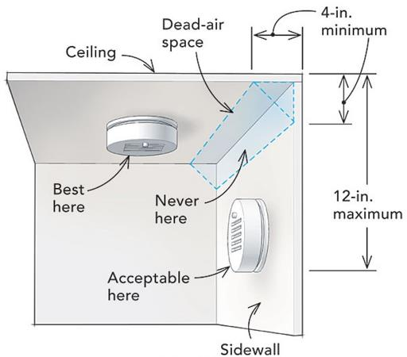
Right Alarm – Right Location
Smoke Alarm Installation Guidelines
Ceiling Installation
Mount smoke alarms toward MIDDLE of ceiling, no closer than four inches from walls.
Wall Installation
If a ceiling mount is not possible, mount alarms on wall no closer than four inches from ceiling.
Notes:
*Source nfpa.org

Slide 14
Right Alarm – Right Location
Smoke Alarm Installation Guidelines
Smoke alarms should NOT be installed
where drafts from fans or air ducts can reach
them.
Moving air can blow smoke away from
alarms.
Install alarms 3’ from ceiling fans or air ducts when possible.
Notes:
*Source nfpa.org

Slide 15
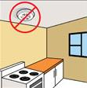
Right Alarm – Right Location
Avoid Nuisance Alarms
To avoid “nuisance” alarms near cooking appliances:
Avoid installing in kitchens
Do not install within 10 feet.
Recommend photoelectric or an alarm equipped with alarm silencing if it must be installed in a kitchen or near a
cooking appliance.
Notes:
*Source nfpa.org

Slide 16
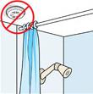
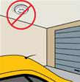
Right Alarm – Right Location
Avoid Nuisance Alarms
  Do not install:
  Within 3 feet of a bathroom door with a tub or shower.
  In a garage.
  On uninsulated exterior walls or ceilings.
  The ceiling of a trailer home is considered an uninsulated surface due to temperature swings.
  Do not install alarms on the celling of a trailer home

Slide 17
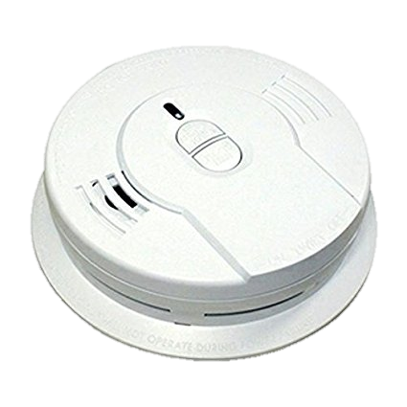
Right Alarm – Right Location
How old is too old for smoke alarms?
An alarm sounding when tested, does not mean it will activate during a home fire.
Smoke alarms should be replaced no later than 10 years from the date of manufacture.
During a home fire, smoke alarms more than 10 years old may:
  Not activate
  Take longer to activate

Slide 18
Right Alarm – Right Location
FIRE SAFE SC recommends:
If a smoke alarm is older than 7 years old, replace it.
When in doubt, replace the alarm.

Slide 19
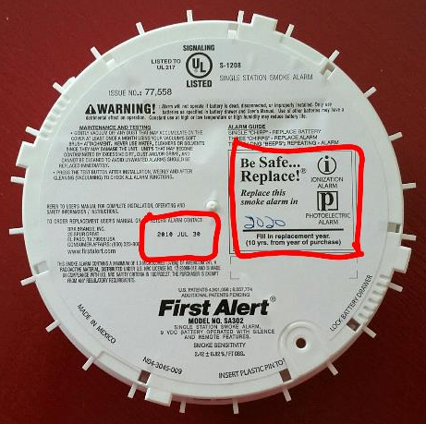
Right Alarm – Right Location
How can I tell how old an alarm is?
Date of manufacture can be found on back of alarms and may be hard to read
When in doubt, REPLACE THE ALARM

Slide 20
Right Alarm – Right Location
Deaf/Hard of Hearing Alarms
“Bed Shaker”
    Works with smoke alarms to awaken those who are deaf/hard of hearing.
    Once device detects a smoke alarm for three cycles, it alerts with a low frequency signal and vibrates the bed.

Slide 21

Right Alarm – Right Location
How old is too old for bed-shakers?
Lifetone alarms
  No expiration date
  Actively listens for smoke alarms and alerts when smoke alarms alert
Follow manufacturer guidelines for the replacement of deaf/hard of hearing alarms.

Slide 22
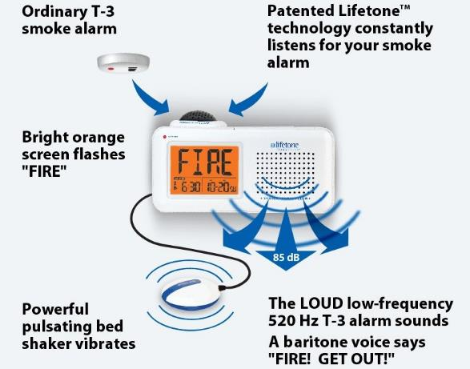
Right Alarm – Right Location
  Deaf/Hard of Hearing Smoke Alarm Installation Guidelines
  Follow the link below for the installation video from Lifetone prior to each installation.
  https://lifetonesafety.com/page_id1085
Notes:
Lifetone Hard of Hearing alarms are easy to install, but a specific procedure and order of operations must be followed.
Since these alarms are not installed frequently by most Fire Safe SC partners, please review the installation instructions separately prior to each installation of a Hard of Hearing Alarm.

Slide 23
Right Alarm – Right Location
Carbon Monoxide Alarms
Carbon Monoxide (CO) is a Poisonous Gas that is:
Deadly
Colorless
Odorless
CO is produced by the incomplete burning of various fuels.

Slide 24
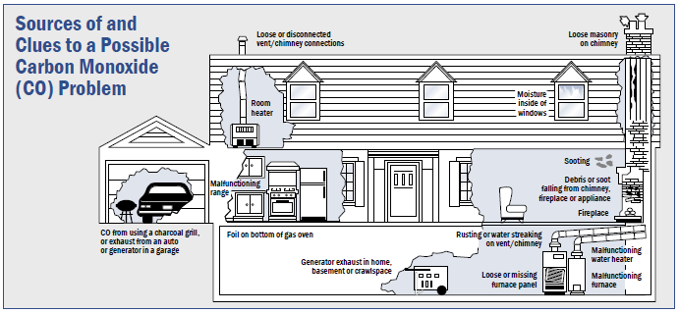
Right Alarm – Right Location
Carbon Monoxide Sources
Furnaces and boilers
Gas stoves and ovens
Fireplaces - gas and
wood burning
Gas Water heaters
Gas Clothes dryers

Slide 25
Right Alarm – Right Location
Carbon Monoxide Sources
Wood stoves
Power generators
Motor vehicles
Gas-powered tools and lawn equipment
Tobacco smoke

Slide 26
Right Alarm – Right Location
For More Information About CO:
Visit the Jeffrey Lee Williams Foundation
https://www.jeffreysfoundation.org
or take the course
“Carbon Monoxide Awareness” presented by the South Carolina Fire Academy in partnership with the Jeffrey Lee Williams Foundation by following the link below:
http://scfaonlinetraining.org/course/index.php?categoryid=1
Notes:
For More Information About CO:
Visit the Jeffrey Lee Williams Foundation
https://www.jeffreysfoundation.org
For More Information About CO:
Take the course
“Carbon Monoxide Awareness” presented by the South Carolina Fire Academy in partnership with the Jeffrey Lee Williams Foundation by following the link below:
http://scfaonlinetraining.org/course/index.php?categoryid=1

Slide 27
Right Alarm – Right Location
How old is too old for Carbon Monoxide Alarms?
Can be rated for 5, 7, or 10 years - depending on manufacturer
Follow manufacturer guidelines for replacement
When in doubt, REPLACE THE ALARM

Slide 28
Right Alarm – Right Location
Carbon Monoxide Alarms
Should be installed in a central location outside each sleeping area and on every level of the home.
CO is found ceiling to floor.
Follow manufacturer instructions for placement and mounting height.
Notes:
Generally, mounting height is not a concern as CO is the same density as room air and is equally distributed across the entire room or space.

Slide 29

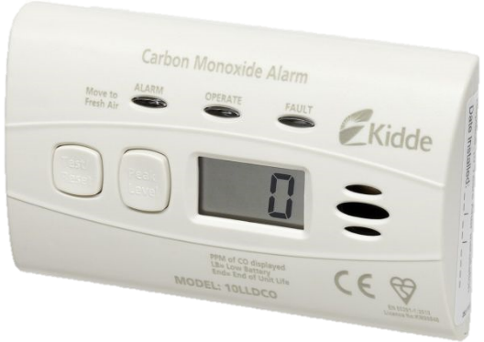
Right Alarm – Right Location
Testing Alarms
Test every alarm after installing it pushing the test button.
Demonstrate proper testing of alarm by pressing and holding the test button.
Depending on the mobility of the resident, have him/her test the smoke alarm to verify proper functioning.

Slide 30
The right alarm in the right location may save a life.

Slide 31
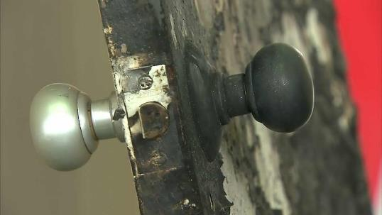
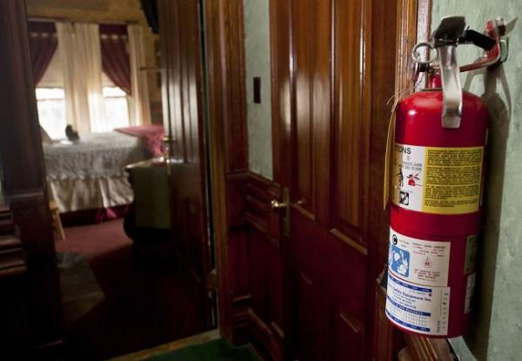
Fire Drill Plans and Prep

Slide 32
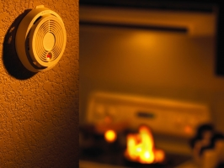
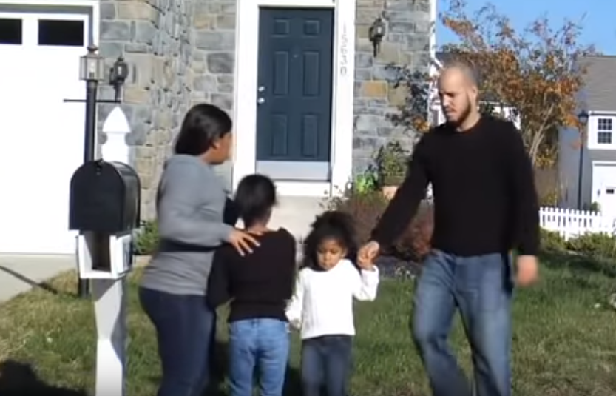
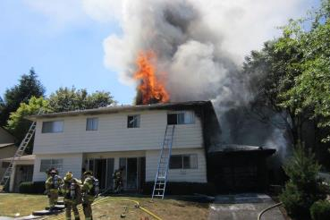
Fire Drill Plans and Prep
Home Fire Drills
Assure Everyone Reacts to EVERY ALARM
Create a plan
Draw it out
Practice, at least twice a year

Slide 33
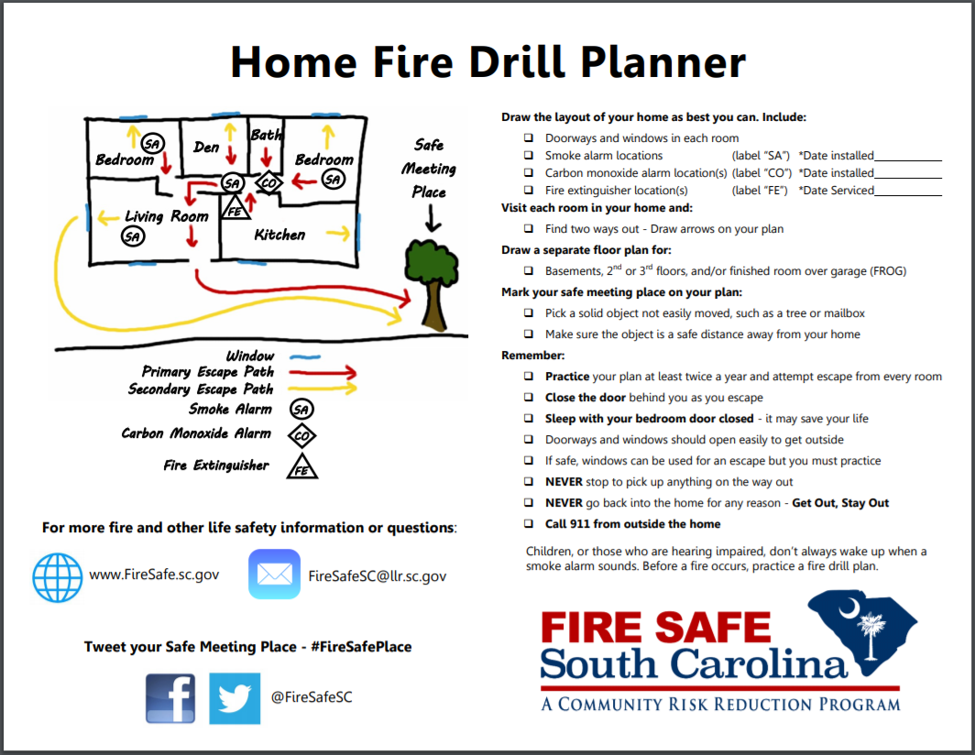
Fire Drill Plans and Prep
Home Fire Drills
Use the Fire Safe SC Home Fire Drill Planner to demonstrate to the resident how to develop a fire escape plan.

Slide 34
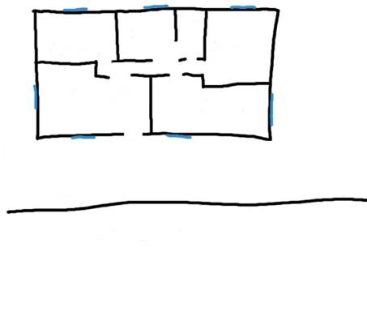
Fire Drill Plans and Prep
Home Fire Drills
Draw a picture of your floor plan

Slide 35
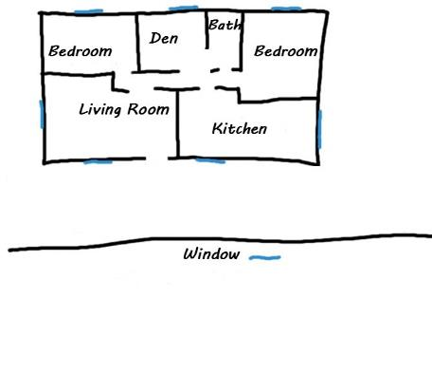
Fire Drill Plans and Prep
Home Fire Drills
Draw a picture of your floor plan
Label each room and mark windows

Slide 36
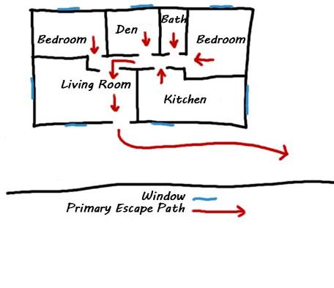
Fire Drill Plans and Prep
Home Fire Drills
Draw a picture of your floor plan
Label each room and mark windows
Draw primary way out of each room

Slide 37
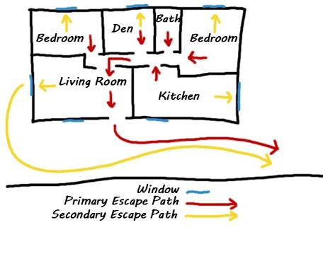
Fire Drill Plans and Prep
Home Fire Drills
Draw a picture of your floor plan
Label each room and mark windows
Draw primary way out of each room
Draw secondary way out of each room

Slide 38
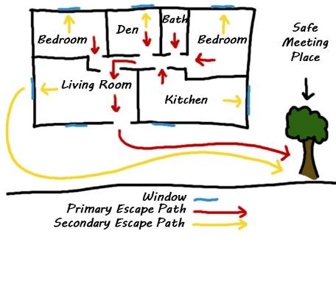
Fire Drill Plans and Prep
Home Fire Drills
Draw a picture of your floor plan
Label each room and mark windows
Draw primary way out of each room
Draw secondary way out of each room
Draw meeting place outside home

Slide 39
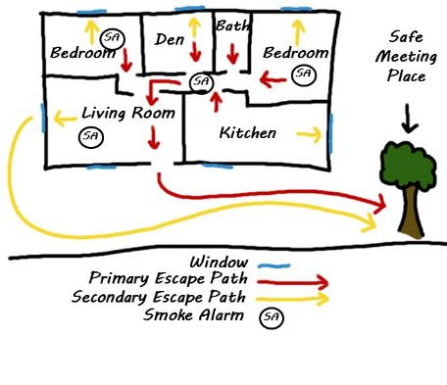
Fire Drill Plans and Prep
Home Fire Drills
Draw a picture of your floor plan
Label each room and mark windows
Draw primary way out of each room
Draw secondary way out of each room
Draw meeting place outside home
Label smoke alarm locations

Slide 40
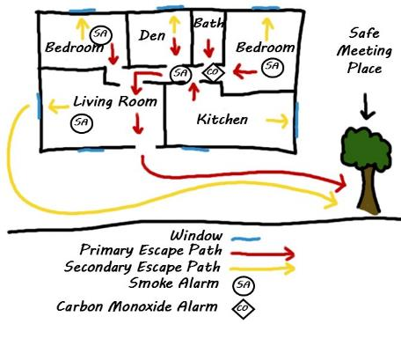
Fire Drill Plans and Prep
Home Fire Drills
Draw a picture of your floor plan
Label each room and mark windows
Draw primary way out of each room
Draw secondary way out of each room
Draw meeting place outside home
Label smoke alarm locations
Label carbon monoxide alarm locations

Slide 41
Fire Drill Plans and Prep
Home Fire Drills
Draw a picture of your floor plan
Label each room and mark windows
Draw primary way out of each room
Draw secondary way out of each room
Draw meeting place outside home
Label smoke alarm locations
Label carbon monoxide alarm locations
Label fire extinguisher locations

Slide 42

Fire Drill Plans and Prep
Home Fire Drills
  Answer these questions after your fire drill:
  How did it go?
    Were there any issues?
    Did everyone follow the plan?
    Do you need to change the plan?
    Remember, if the plan changes,
    you must practice it again.
    Practice at least twice a year.

Slide 43
Practicing fire drills in the home may save a life.

Slide 44
Fire Drill Plans and Prep
Close before you doze.
Six reasons to sleep with your bedroom door closed:
Slows the spread of deadly smoke
Gives you more time to wake up
Gives you more time to escape

Slide 45
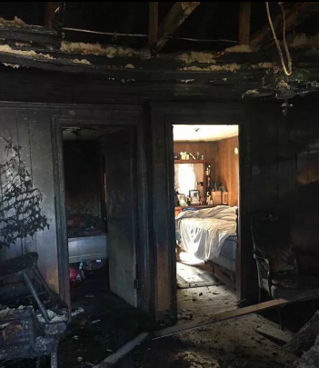
Fire Drill Plans and Prep
Close before you doze.
Six reasons to sleep with your bedroom door closed:
Slows the growth of fire
Slows the spread of fire
Confines the fire to a smaller area

Slide 46
Sleeping with doors closed
may save a life.

Slide 47
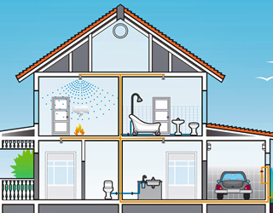
Fire Sprinklers Save Lives

Slide 48
Fire Sprinklers Save Lives
Common Myths to Correct:
Cost?
Deluge vs. single action?
Leaking or accidental activation?
Smoke alarms tied to sprinklers?
Notes:
Fire Sprinklers costs less than $2 per square foot.
Less than the sprinkler system that waters the grass.
Less than the cost of high end counter tops or whirl pool tubs.
Only the sprinkler head at the fire activates. Sprinklers are activated by heat, not smoke. They will not go off unless there is an actual fire in your home.
NFPA's "U.S. Experience with Sprinklers" report found the majority of residents living in sprinklered homes never experience a leak or maintenance problem.
Sprinklers are not tied to smoke alarms. Each individual sprinkler head activates between 135° - 165° Fahrenheit. They do not operate in response to an active smoke alarm, smoke, burned toast, cooking vapors, or steam.

Slide 49
Properly installed and maintained fire sprinklers
save lives.

Slide 50
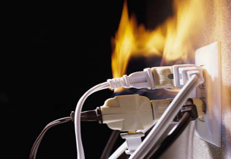
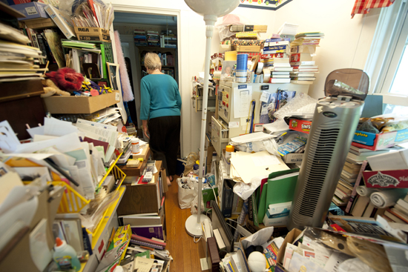
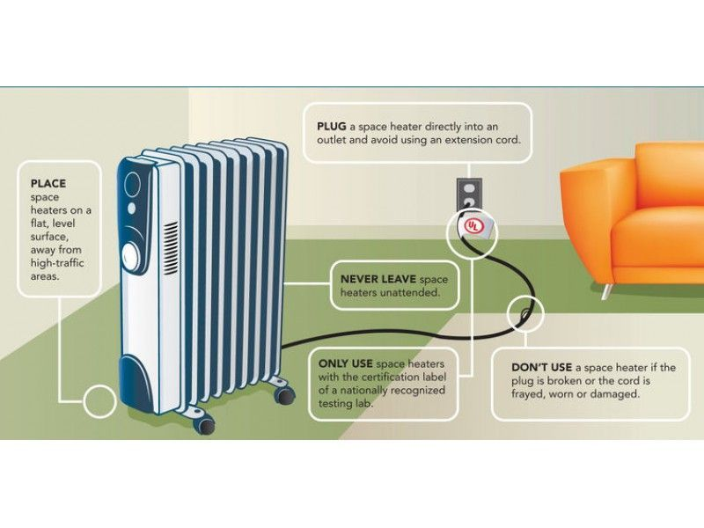
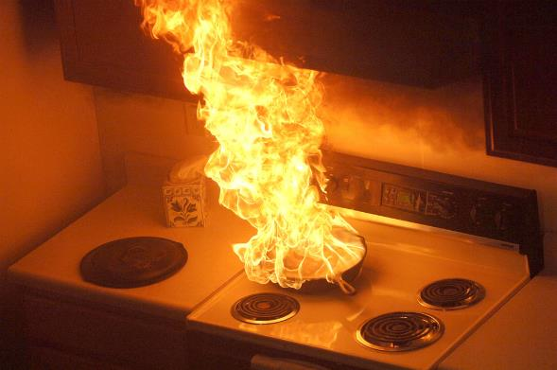

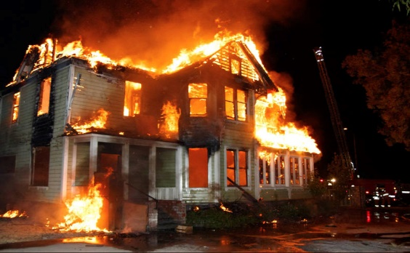
See a Problem – Take Action

Slide 51

See a Problem – Take Action
When you see a potential hazard that could harm someone, take action.
If you can’t fix it, ask for help.
Your action may save a life.
Notes:
State Fire is a resource when you see a problem and are not sure what action to take.

Slide 52
See a Problem – Take Action
Electrical Distribution or
Lighting Equipment
Electrical fire causes result in…
18% of the home fire deaths
10% of the home fire injuries
19% of the direct property damage
These fires involved equipment such as wiring, lighting, cords and plugs.
Notes:
*Source National Fire Protection Association - "Electrical Fires“ report

Slide 53
See a Problem – Take Action
Space Heaters
Portable space heaters are consistently a leading factor in home fire fatalities.
Portable space heaters are involved in
43% of home heating fires
85% of home heating fire deaths
Notes:
*Source National Fire Protection Association - “Home Fires Involving Heating Equipment“ report
Nearly half (48%) of all home heating fires occurred in December, January and February.

Slide 54
See a Problem – Take Action
Falls are a leading cause of injury among older adults
What Increases fall risk?
Medical conditions
Medication(s)
Footwear
Lack of lighting
Notes:
*Source Mayo Clinic – Healthy Aging, Fall Prevention

Slide 55
See a Problem – Take Action
Falls are a leading cause of injury among older adults
What Increases fall risk?
Trip hazards
  Clutter in high traffic areas
  Electrical cords
  Loose rugs
  Flooring irregularities/damage
  Spills
Notes:
*Source Mayo Clinic – Healthy Aging, Fall Prevention

Slide 56
See a Problem – Take Action
Hoarding disorder is a persistent difficulty discarding or parting with possessions because of a perceived need to save them.
A person with hoarding disorder experiences distress at the thought of getting rid of the items.
Excessive accumulation of items, regardless of actual value, occurs.
Notes:
*Source Mayo Clinic – Hoarding Disorder

Slide 57
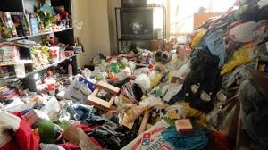
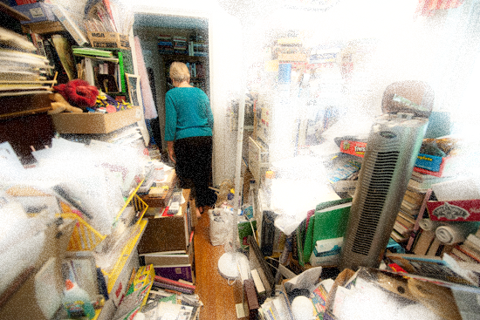
See a Problem – Take Action
Hoarding disorder
Nearly 2 out of 5 (37%) fatal structure fires in 2019 had hoarding issues
Notes:
*Source S.C. Office of State Fire Marshal – S.C. State NFIRS

Slide 58
See a Problem – Take Action
Cooking Fires
Impact of Cooking Equipment Fires
Cooking equipment is involved in
48% of home fires
21% of home fire deaths
45% of home fire injuries
Frying dominates the cooking fire problem.
Notes:
*Source National Fire Protection Association - Based on 2012-2016 annual averages

Slide 59
See a Problem – Take Action
Cooking Fires
Impact of Cooking Equipment Fires
Unattended equipment is a factor in one-third (32%) of reported home cooking fires and half (45%) of the associated deaths.
Notes:
*Source National Fire Protection Association - Based on 2012-2016 annual averages
Thanksgiving is the peak day for home cooking fires, followed by Christmas Day and Christmas Eve.

Slide 60
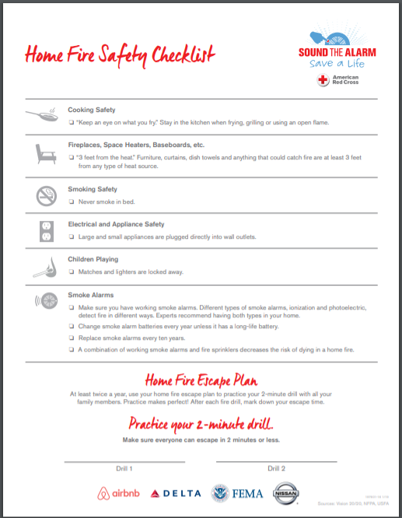
See a Problem – Take Action
Use the American Red Cross Sound the Alarm Home Fire Safety Checklist to remind you of some of these common fire risks.

Slide 61
See a Problem – Take Action
When you see a potential hazard that could harm someone, take action.
If you can’t fix it, ask for help.
Fire Safe South Carolina
803-896-9800
FireSafeSC@llr.sc.gov
Or make a referral:
http://firesafe.sc.gov/engage.html

Slide 62
Taking action when you see a problem may save a life.

Slide 63

Do you have any questions?
Notes:
Does anyone have any questions about our mission today?
This provided the education on consistent messaging to new partners as an introduction.

